Slide 1
DEVELOPMENT OF AN ONLINE CRIME REPORTING SYSTEM
PRESENTATION
BY
ETUKUDOH, UNWANA THERESA
AK15/NAS/CSC/022
NOVEMBER, 2020.

Slide 2
OUTLINE
1
INTRODUCTION
STATEMENT OF THE PROBLEM
AIM AND OBJECTIVES
RELATED LITERATURE
EXISTING SYSTEM
RESEARCH METHODOLOGY
PROPOSED ARCHITECTURE
REFERENCES

Slide 3
INTRODUCTION
2
Crime can be described as an offense (or criminal offense), an act that is harmful not only to some individual but also to a community, society or the state ("a public wrong").
An ideal society is governed by laws and regulations that are collectively agreed upon and measurable consequences that will be meted out for any member of the society that is found culpable to have floated any specific component of the legal infrastructure.
The hunt to control the rate of crime and breakdown of law and order increases each day.

Slide 4
INTRODUCTION CONTINUE...
3
Members of the society have several responsibilities to the government of which such include reporting any incidence of breakdown of law and order to the appropriate civil and security agency.
Until lately, the process of reporting a crime case is tedious as it is manually done. However, the introduction of technology has set a new front of opportunities of leveraging on the assorted benefits of information technology to crime reporting.

Slide 5
STATEMENT OF THE PROBLEM
4
Crime and illegal human activities have always been part of the society and are being committed in various locality including tertiary institutions.
These crimes are being committed every day and which most of these crimes committed were unreported to the authorities because of the fear of getting involved, costs and time incurred in traveling to police stations that are situated far from their homes and workplaces, lengthen processes involve in laying crime incident statement at the station and also at times language barrier.
However, considering school environment, many crime incidents are not being reported to the school authority because of fear of intimidation, time, and or who to report to.
It is essential to have well organized and widely available method for reporting criminal activities to the relevant authorities and support for quick response units.

Slide 6
AIM AND OBJECTIVES
5
The aim of this research work is to develop an Online Crime Reporting System that will be easily accessible to people to report crime and any illegal activities within one’s locality.
The objectives are as follows:
To design a system that is easily accessible by the people for making crime report.
To design a database for proper safekeeping of data (crime record)
To develop a prototype system using PHP, JavaScript, Java as programming languages, and MySQL for database, and Visual Studio Code IDE.

Slide 7
RELATED LITERATURE
6
AUTHOR/YEAR | WHAT THEY DID | LIMITATIONS
Jimoh, Ojulari, & Enikuomehin (2014) | The researchers conducted a research work on a Scalable Online Crime Reporting System. The system consists of three functional modules: a data capture module, a report management and control module, and a data utilization module. | The system was not tailored towards accessibility (mobile version), awareness and improvement on the usage.
Archana & Durga, (2016) | Developed an Online Crime Reporting System that helps manage criminal details in a centralized database and provide solution for public to give complaint through online. The system was implemented using C#, ASP and SQL Server | The system did not implement the QR code scan for the privacy of the user while downloading the FIR details.

Slide 8
RELATED LITERATURE CONTINUE...
7
AUTHOR/YEAR | WHAT THEY DID | LIMITATIONS
Yugandhar & Muni (2018) | Crime Reporting System. The authors developed a software that provides facility for reporting online crimes, complaints, missing persons, show criminal details. The software was developed with modular approach. | Multilingual support can be provided so that it can be understandable by the person of any Language.
Selvakani, Vasumathi & Harikaran (2019) | A Web Based Online Crime Reporting System. The framework comprises of three useful modules: an information catch module, a report the board and control module, and an information usage module. | The system lacks Multilingual.

Slide 9
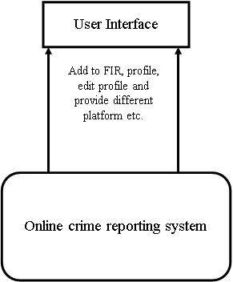
EXISTING ARCHITECTURE
8
Architecture of the existing system (Jimoh R. et al., 2014)

Slide 10
RESEARCH METHODOLOGY
9
The research methodology adopted for this research work is the secondary data source collection. The secondary data collection is the collection of an already made data, information obtained from sources like journals, textbook, magazines, internet. In order to achieve these research objectives the below procedures will be followed;
Conducting a preliminary study on the existing systems.
Designing the system using UML diagrams.
Developing the system using agile software development model.
Implementing a prototype system using PHP, Javascript, Java as programming languages, MySQL for database, and Visual Studio Code IDE.
The software development model employed is the Agile Methodology approach.

Slide 11
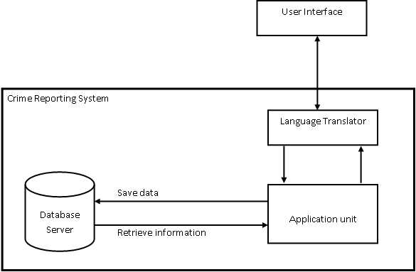
PROPOSED ARCHITECTURE
10

Slide 12
REFERENCES
11
Archana, M., & Durga, S. (2016). Online Crime Reporting System. International Journal Of Advanced Networking & Applications (IJANA) , 1 (1), 297-299.
Jimoh, R., Ojulari, K., & Enikuomehin, O. (2014). A Scalable Online Crime Reporting System. African Journal of Computing & ICT , 7 (1), 11-20.
Selvakani, S., Vasumathi, K., & Harikaran, M. (2019). Web Based Online Crime Reporting System using Asp.Net. International Journal of Innovative Technology and Exploring Engineering (IJITEE) ,
8 (10), 2278-3075.
Yugandhar, P., & Muni, A. (2018). Online Crime Reporting System. Journal Of Innovative Research In Technology , 4 (11), 1745-1748.

Slide 13
THANKS FOR LISTENING

